Slide 1


Major Project
Language Annotation Tool with NER and ML Translation
Presented by:
R2142230323 - Aastha Jaiswal
R2142231569 - Muskan Mittal
R2142230703 - Astha Gupta
Mentored By:
Dr. Sumit Singh

Slide 2
Introduction
Natural Language Processing (NLP) enables computers to understand, process and analyse human language.
The proposed system is an AI-based multitask NLP tool designed to analyse textual content through three major tasks:
  Named Entity Recognition (NER): Identifies entities such as people, locations, organizations, dates and other important information.
  Question & Answer Generation: Takes a paragraph as input and automatically generates relevant questions along with their answers.
  Sentiment & Mood Analysis: Analyses textual feedback and predicts a 1–5 sentiment rating along with a mood/emotion-oriented category.
The system aims to provide automated text understanding, educational content generation and opinion analysis through a single platform.
The project focuses particularly on Indian-language NLP, where challenges such as limited resources, spelling variations and linguistic diversity make text processing more difficult. The HiNER study highlights these challenges for Hindi NER.

Slide 3
Literature Review
Paper | Year | Relevance | Links
HiNER: A Large Hindi Named Entity Recognition Dataset | 2022 | Provides a large Hindi NER dataset and benchmarks transformer-based models for entity recognition. | https://aclanthology.org/2022.lrec-1.475/
Gala et al. – IndicTrans2 | 2023 | Developed multilingual translation models for all 22 scheduled Indian languages, supporting multilingual processing. | [2305.16307] IndicTrans2: Towards High-Quality and Accessible Machine Translation Models for all 22 Scheduled Indian Languages
He et al. – AnnoLLM | 2023 | Proposed an LLM-based approach for automated data annotation, reducing dependence on manual annotation. | [2303.16854] AnnoLLM: Making Large Language Models to Be Better Crowdsourced Annotators
Zhang et al. – LLMaAA | 2023 | Used LLMs as active annotators for NLP tasks such as NER, supporting human-in-the-loop annotation. | [2310.19596] LLMaAA: Making Large Language Models as Active Annotators
Bahad et al. – Fine-tuning NER Models for Indian Languages | 2024 | Investigated transformer fine-tuning for NER across Indian languages and demonstrated transfer-learning potential. | [2405.04829] Fine-tuning Pre-trained Named Entity Recognition Models For Indian Languages
Recent Developments in NER for Indian Languages | 2026 | Provides a comprehensive review of NER techniques, datasets and challenges for Indian languages. | Recent developments in named entity recognition techniques for Indian languages: A comprehensive review - ScienceDirect

Slide 4
Objective
Develop an NER module to identify and classify important entities such as Person, Location, Organization, Date, etc.
Develop a Question Generation module that generates relevant questions and answers from a given paragraph.
Develop a Sentiment Analysis module to predict a 1–5 rating from textual input.
Analyse emotion/mood-oriented patterns associated with the predicted sentiment.
Integrate the three NLP modules into a single user-friendly AI platform.
Evaluate model performance using appropriate NLP evaluation metrics for each task.

Slide 5
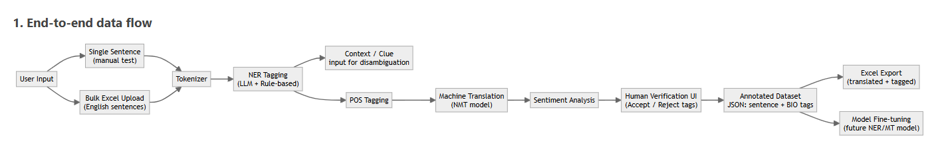
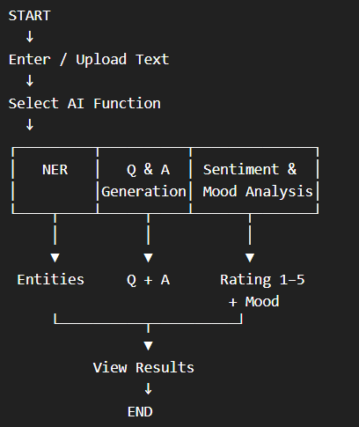
Methodology
Phase M1 | M2 | M3 | M4 | M5 | M6
----------------------------------------------------------------------------------------------
Requirement Analysis ██
System Design ██ ██
Dataset & Preprocessing ██
NER Development ██
Question Generation ██ ██
Sentiment & Mood ██
System Integration ██
Testing & Evaluation ██
Deployment & Documentation ██

Slide 6
Reference
Murthy, R., Bhattacharjee, P., Sharnagat, R., Khatri, J., Kanojia, D., & Bhattacharyya, P. (2022). HiNER: A Large Hindi Named Entity Recognition Dataset. LREC 2022.
Kakwani, D., Kunchukuttan, A., Golla, S., et al. (2020). IndicNLPSuite: Monolingual Corpora, Evaluation Benchmarks and Pre-trained Multilingual Language Models for Indian Languages. EMNLP Findings 2020.
Gala, J., Chitale, P. A., et al. (2023). IndicTrans2: Towards High-Quality and Accessible Machine Translation Models for all 22 Scheduled Indian Languages. arXiv:2305.16307.
He, X. et al. (2023). AnnoLLM: Making Large Language Models to Be Better Crowdsourced Annotators. arXiv:2303.16854.
Zhang, R. et al. (2023). LLMaAA: Making Large Language Models as Active Annotators. arXiv:2310.19596.
(2024). Fine-tuning Pre-trained Named Entity Recognition Models For Indian Languages. NAACL Student Research Workshop 2024.
(2024/2025). Recent Developments in Named Entity Recognition Techniques for Indian Languages: A Comprehensive Review. ScienceDirect.

Slide 7
Thank You

